Slide 1
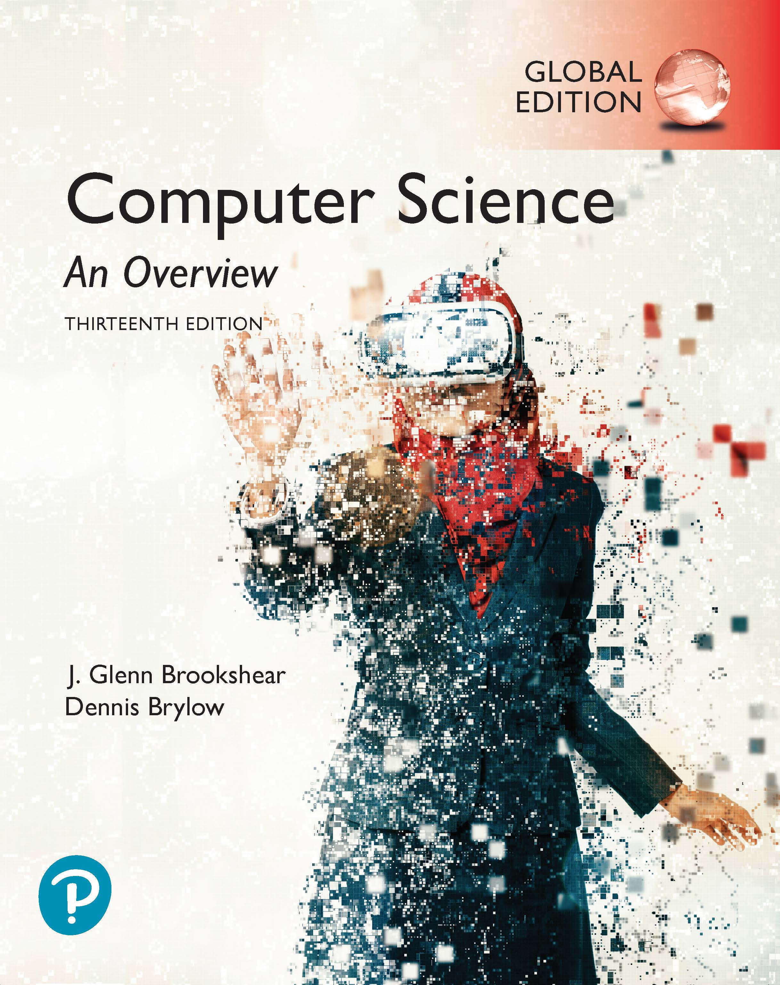
Computer Science An Overview
13th Edition, Global Edition
Chapter 6
Programming Languages

Slide 2
Chapter 6: Programming Languages
6.1 Historical Perspective
6.2 Traditional Programming Concepts
6.3 Procedural Units
6.4 Language Implementation
6.5 Object Oriented Programming
6.6 Programming Concurrent Activities
6.7 Declarative Programming

Slide 3
6.1 Historical Perspective
Early Generations
  Machine Language (e.g. Vole)
  Assembly Language
Machine Independent Language
Beyond – more powerful abstractions

Slide 4
Second-generation:
Assembly language
A mnemonic system for representing machine instructions
  Mnemonic names for op-codes
  Program variables or identifiers: Descriptive names for memory locations, chosen by the programmer

Slide 5
Assembly Language Characteristics
One-to-one correspondence between machine instructions and assembly instructions
  Programmer must think like the machine
Inherently machine-dependent
Converted to machine language by a program called an assembler

Slide 6
Program Example
Machine language
156C
166D
5056
30CE
C000
Assembly language
LD R5, Price
LD R6, ShipCharge
ADDI R0, R5 R6
ST R0, TotalCost
HLT

Slide 7
Third Generation Language
Uses high-level primitives
  Similar to our pseudocode in Chapter 5
Machine independent (mostly)
Examples: FORTRAN, COBOL
Each primitive corresponds(對應) to a sequence of machine language instructions
Converted to machine language by a program called a compiler

Slide 8
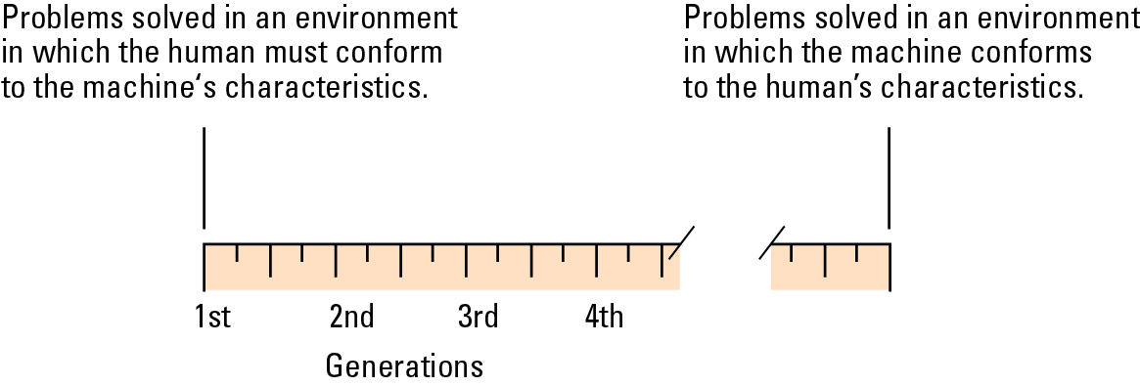
Figure 6.1 Generations of programming languages

Slide 9
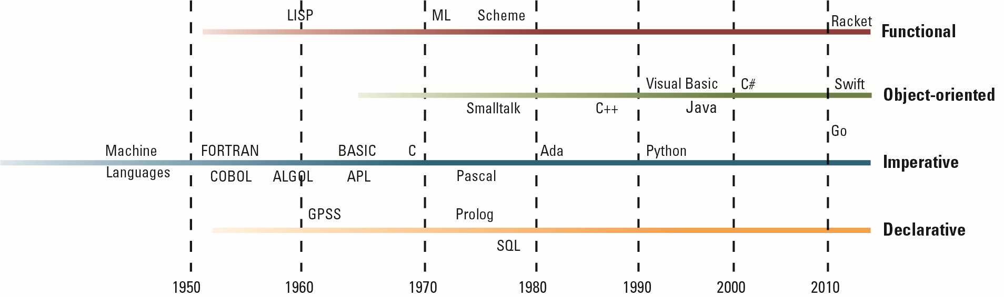
Figure 6.2 The evolution of programming paradigms

Slide 10
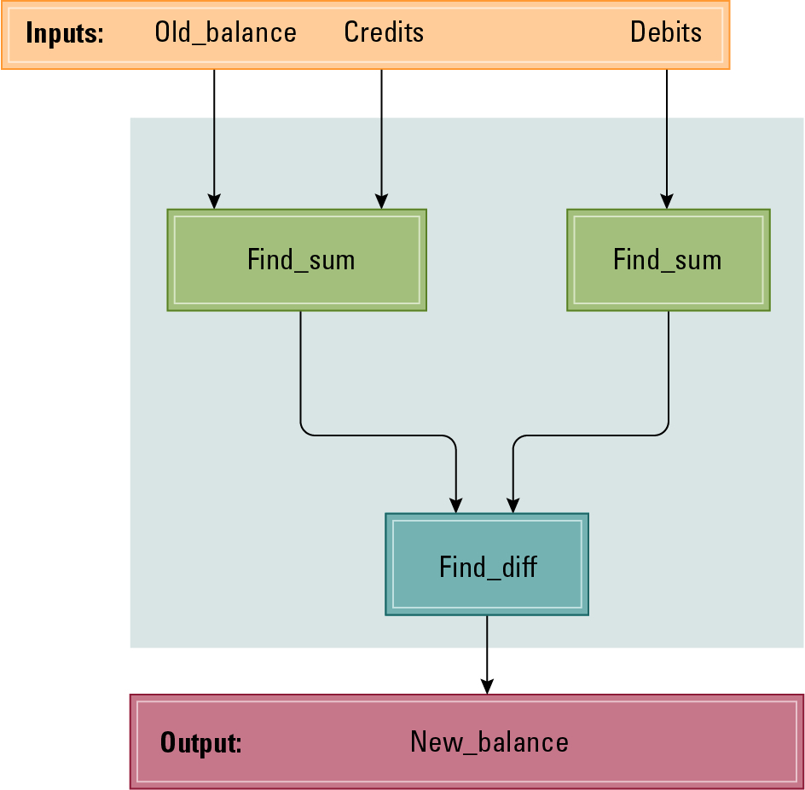
Figure 6.3 A function for checkbook balancing constructed from simpler functions

Slide 11
6.2 Traditional Programming Concepts
High-level languages (C, C++, Java, C#, FORTRAN) include many kinds of abstractions
  Simple: constants, literals, variables
  Complex: statements, expressions, control
  Esoteric: procedures, modules, libraries

Slide 12
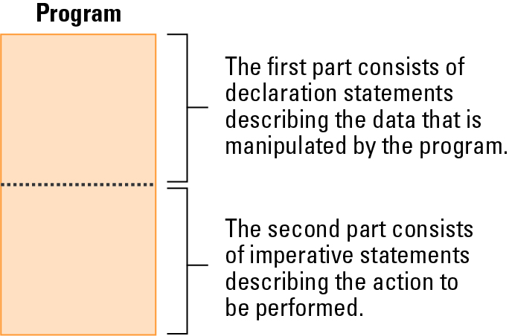
Figure 6.4 The composition of a typical imperative program or program unit

Slide 13
Data Types
Integer: Whole numbers
Real (float): Numbers with fractions
Character: Symbols
Boolean: True/false

Slide 14
Variables and Data types
float Length, Width;
int Price, Total, Tax;
char Symbol;
int WeightLimit = 100;

Slide 15
Data Structure
Conceptual shape or arrangement of data
A common data structure is the array
  In C
  int Scores[2][9];
  In FORTRAN
  INTEGER Scores(2,9)

Slide 16
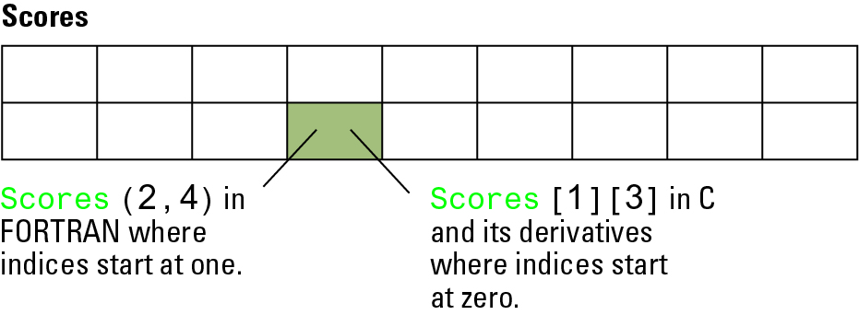
Figure 6.5 A two-dimensional array with two rows and nine columns

Slide 17
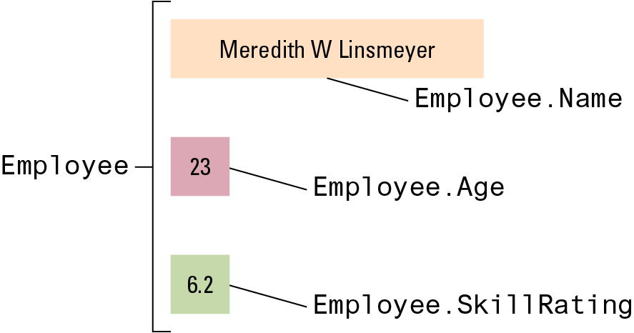
Figure 6.6 The conceptual structure of the aggregate type Employee
struct { char Name[25];
int Age;
float SkillRating;
} Employee;

Slide 18
Assignment Statements
In C, C++, C#, Java
Z = X + y;
In Ada
Z := X + y;
In APL (A Programming Language)
Z ← X + y

Slide 19
Control Statements
Go to statement
goto 40
20 Evade()
goto 70
40 if (KryptoniteLevel < LethalDose) then goto 60
goto 20
60 RescueDamsel()
70 ...
As a single statement
if (KryptoniteLevel < LethalDose):
RescueDamsel()
else:
Evade()

Slide 20
Control Statements (continued)
If in Python
if (condition):
statementA
else:
statementB
In C, C++, C#, and Java
if (condition) statementA; else statementB;
In Ada
IF condition THEN
statementA;
ELSE
statementB;
END IF;

Slide 21
Control Statements (continued)
While in Python
while (condition):
body
In C, C++, C#, and Java
while (condition)
{ body }
In Ada
WHILE condition LOOP
body
END LOOP;

Slide 22
Control Statements (continued)
Switch statement in C, C++, C#, and Java
switch (variable) {
case 'A': statementA; break;
case 'B': statementB; break;
case 'C': statementC; break;
default: statementD; }
In Ada
CASE variable IS
WHEN 'A'=> statementA;
WHEN 'B'=> statementB;
WHEN 'C'=> statementC;
WHEN OTHERS=> statementD;
END CASE;

Slide 23
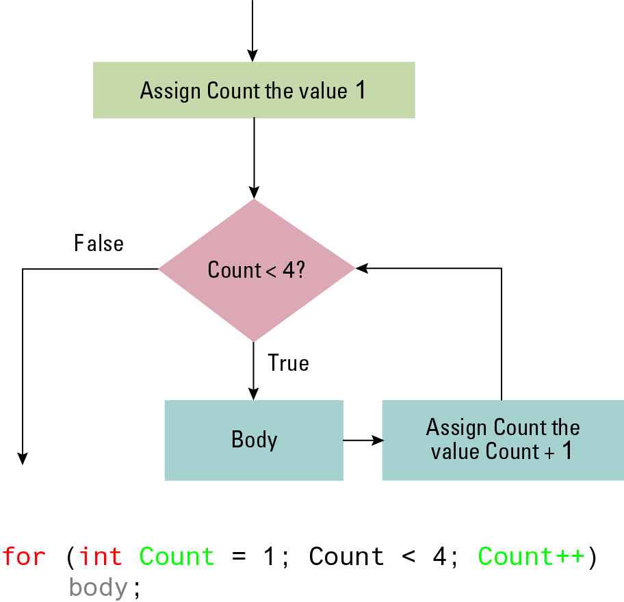
Figure 6.7 The for loop structure and its representation in C++, C#, and Java

Slide 24
Comments
Explanatory statements within a program
Helpful when a human reads a program
Ignored by the compiler
/* This is a comment in C/C++/Java. */
// This is a comment in C/C++/Java.

Slide 25
6.3 Procedural Units
Many terms for this concept:
  Subprogram, subroutine, procedure, method, function
Unit begins with the function’s header
Local versus Global Variables
Formal versus Actual Parameters
Passing parameters by value versus reference

Slide 26
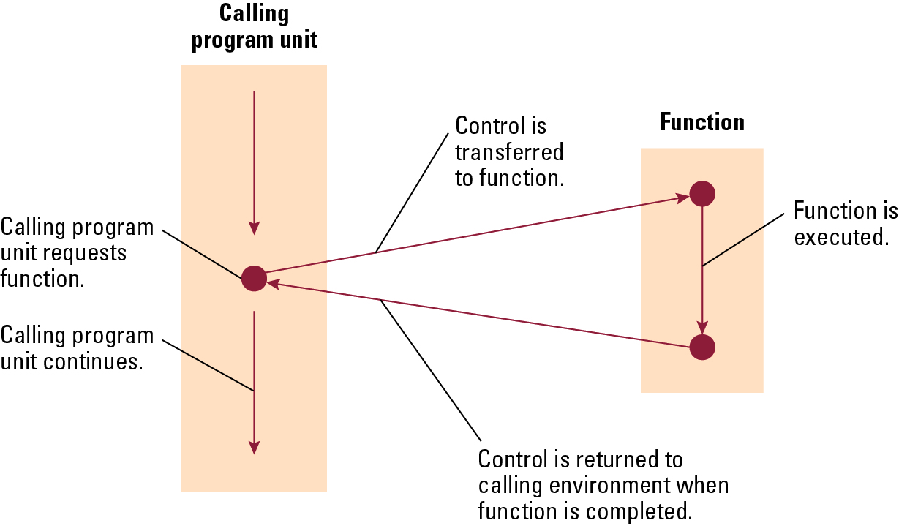
Figure 6.8 The flow of control involving a function

Slide 27
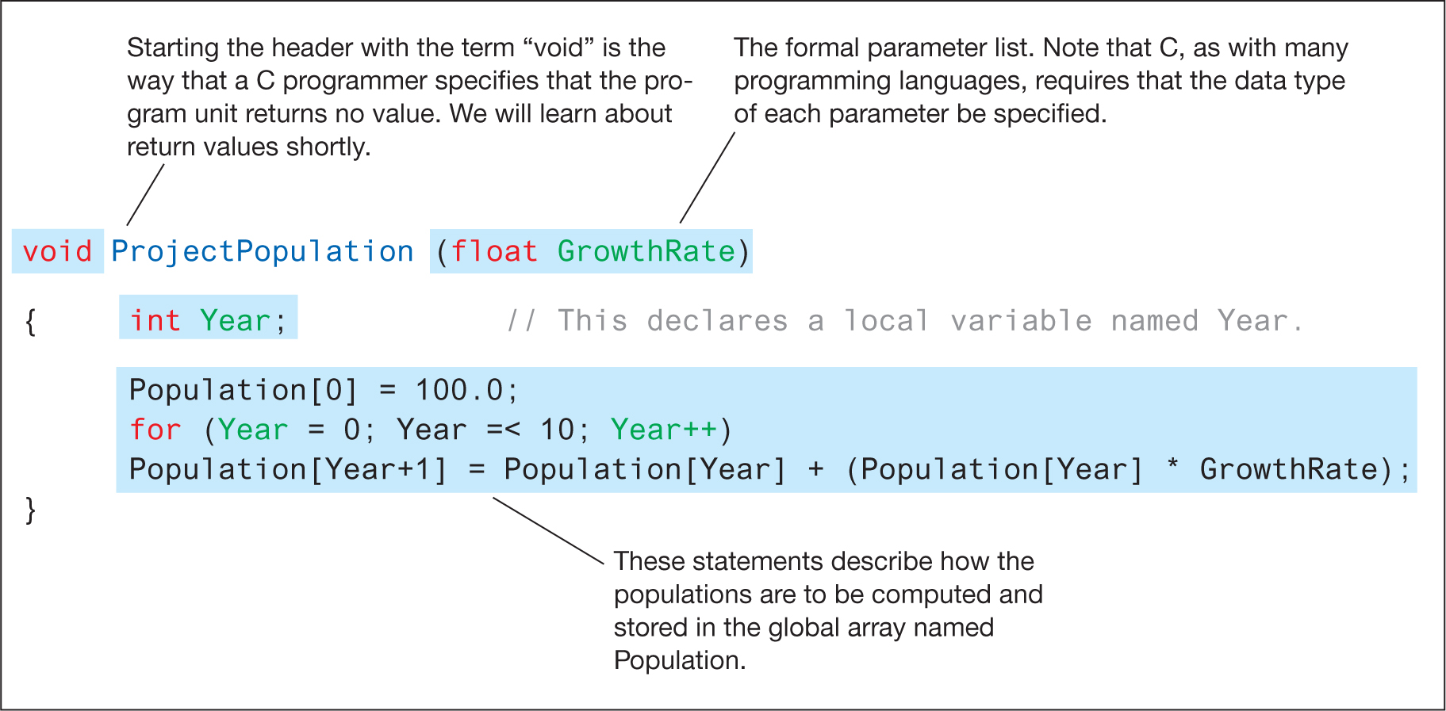
Figure 6.9 The function ProjectPopulation written in the programming language C

Slide 28
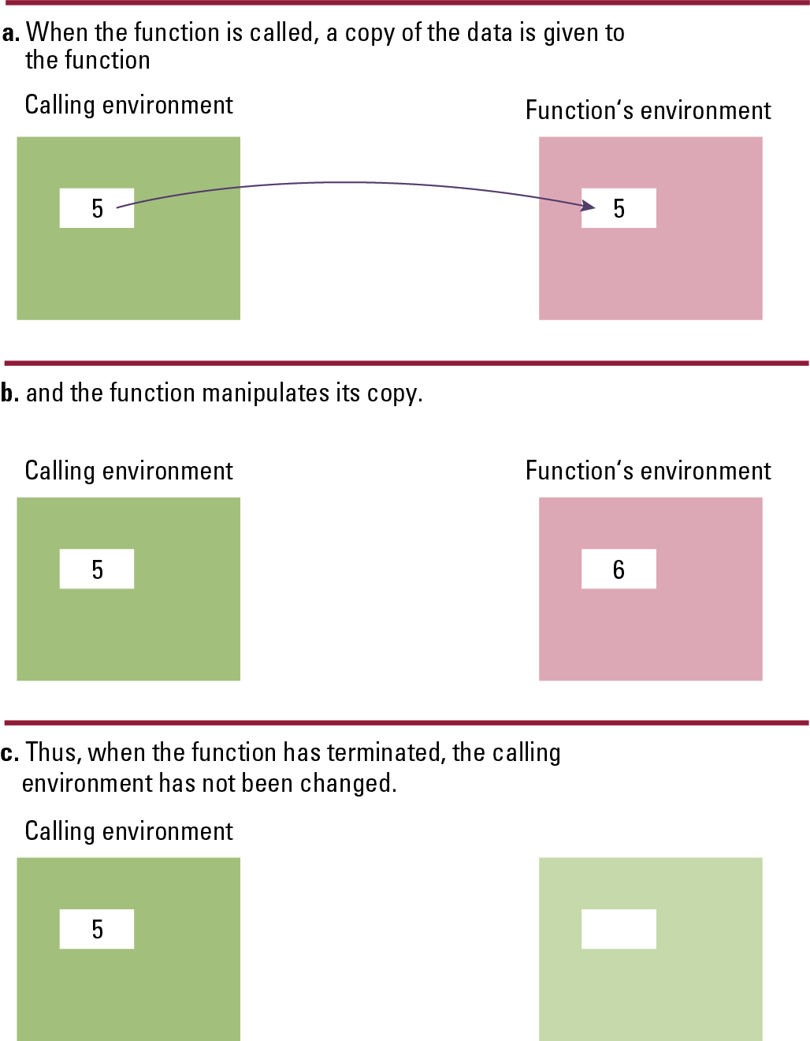

Figure 6.10 Executing the function Demo and passing parameters by value
Copyright © 2019 Pearson Education, Ltd. All Rights Reserved.

Slide 29
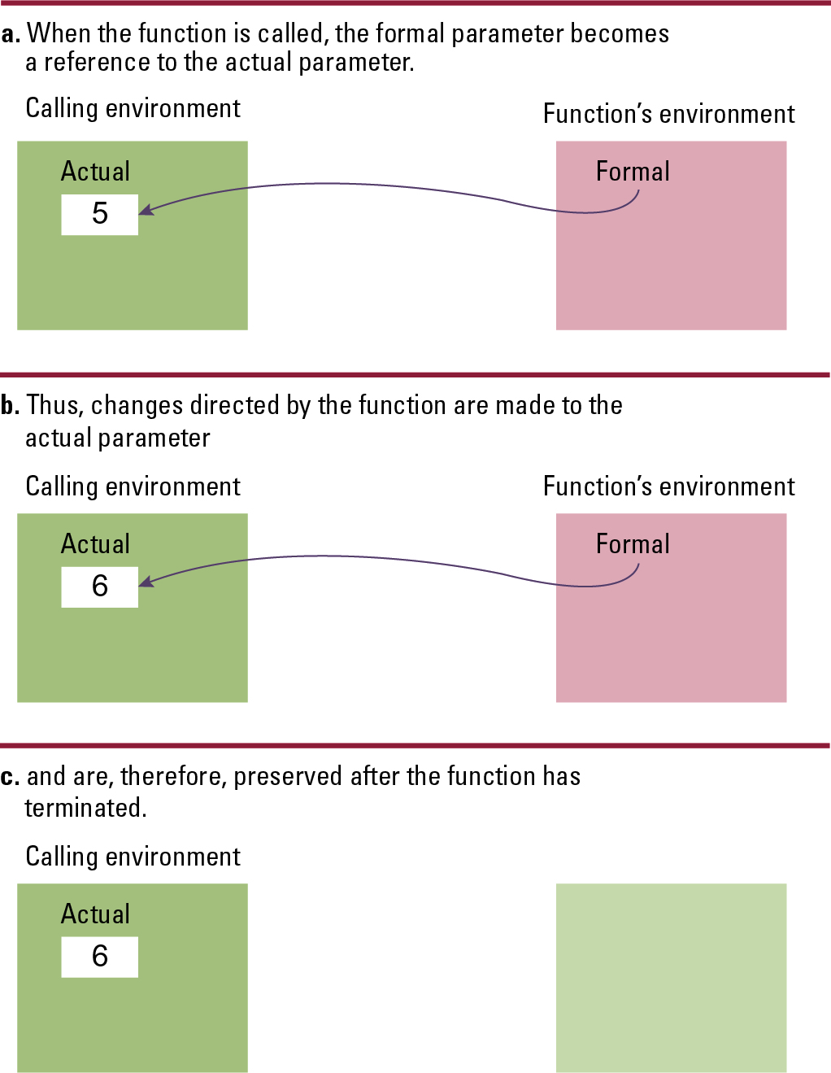
Figure 6.11 Executing the function Demo and passing parameters by reference
Copyright © 2019 Pearson Education, Ltd. All Rights Reserved.

Slide 30
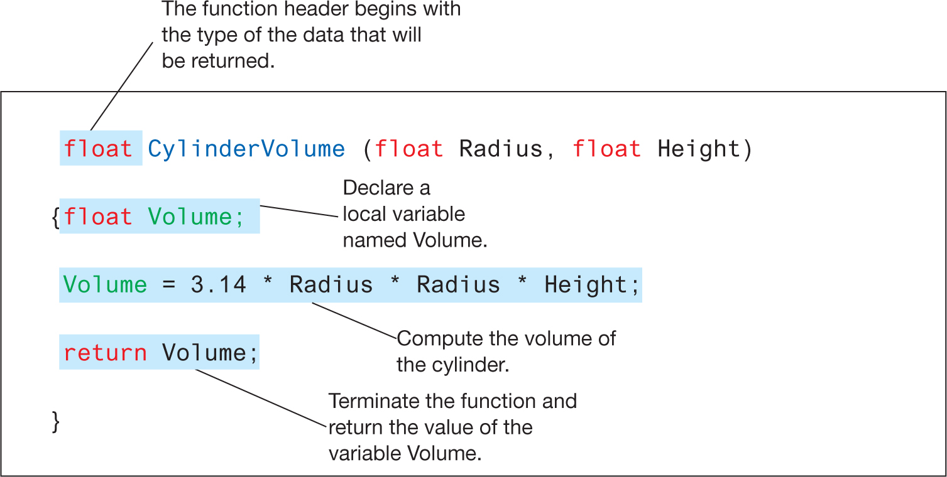
Figure 6.12 The fruitful function CylinderVolume written in the programming language C

Slide 31
6.4 Language Implementation 12/19
The process of converting a program written in a high-level language into a machine-executable form.
  The Lexical Analyzer recognizes which strings of symbols represent a single entity, or token.
  The Parser groups tokens into statements, using syntax diagrams to make parse trees.
  The Code Generator constructs machine-language instructions to implement the statements.

Slide 32
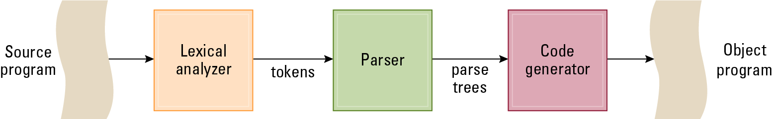
Figure 6.13 The translation process

Slide 33
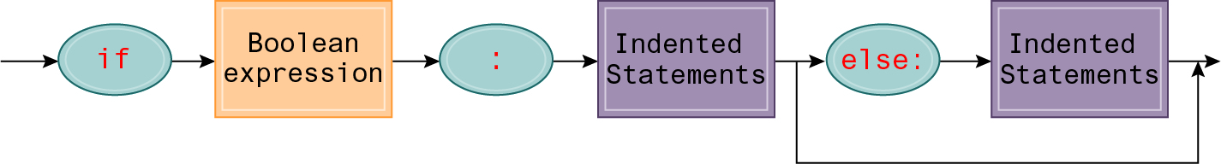
Figure 6.14 A syntax diagram of Python’s if-then-else statement

Slide 34
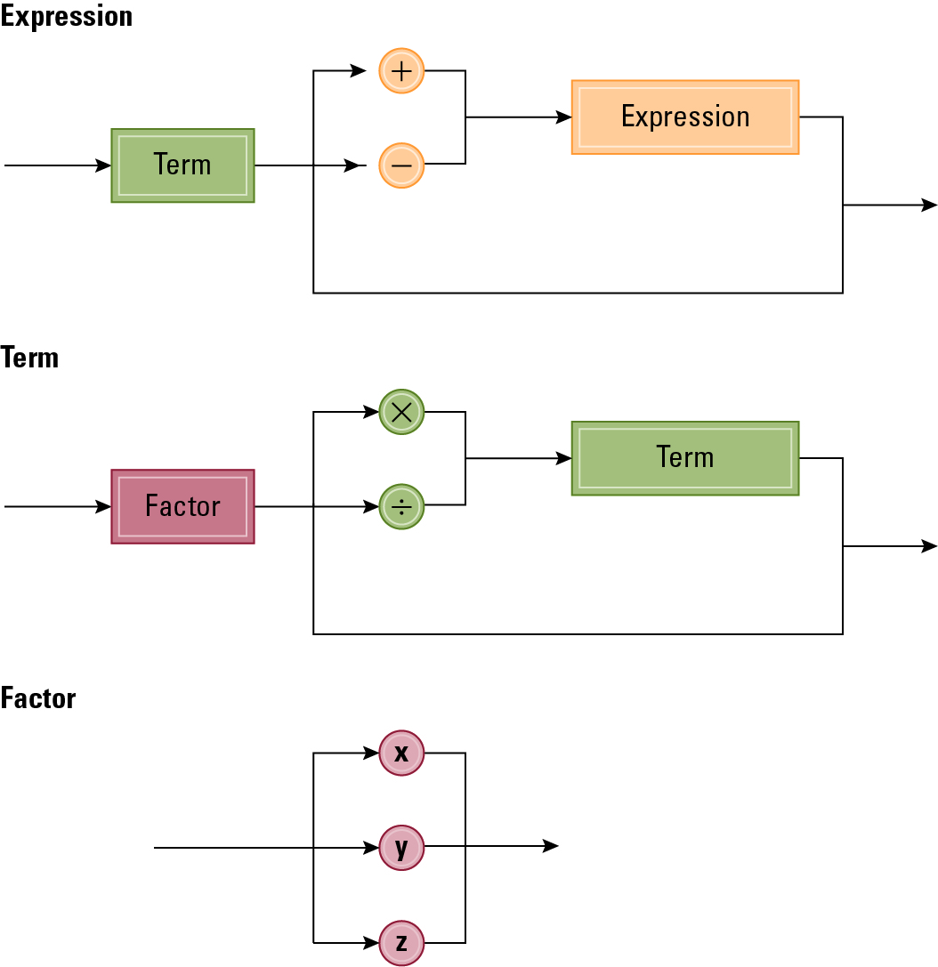
Figure 6.15 Syntax diagrams describing the structure of a simple algebraic expression

Slide 35
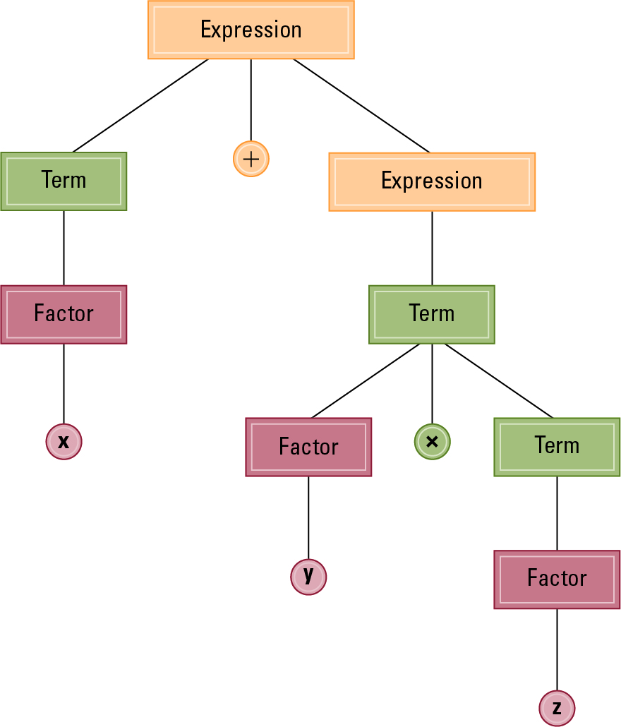
Figure 6.16 The parse tree for the string x + y * z based on the syntax diagrams in
Figure 6.17

Slide 36
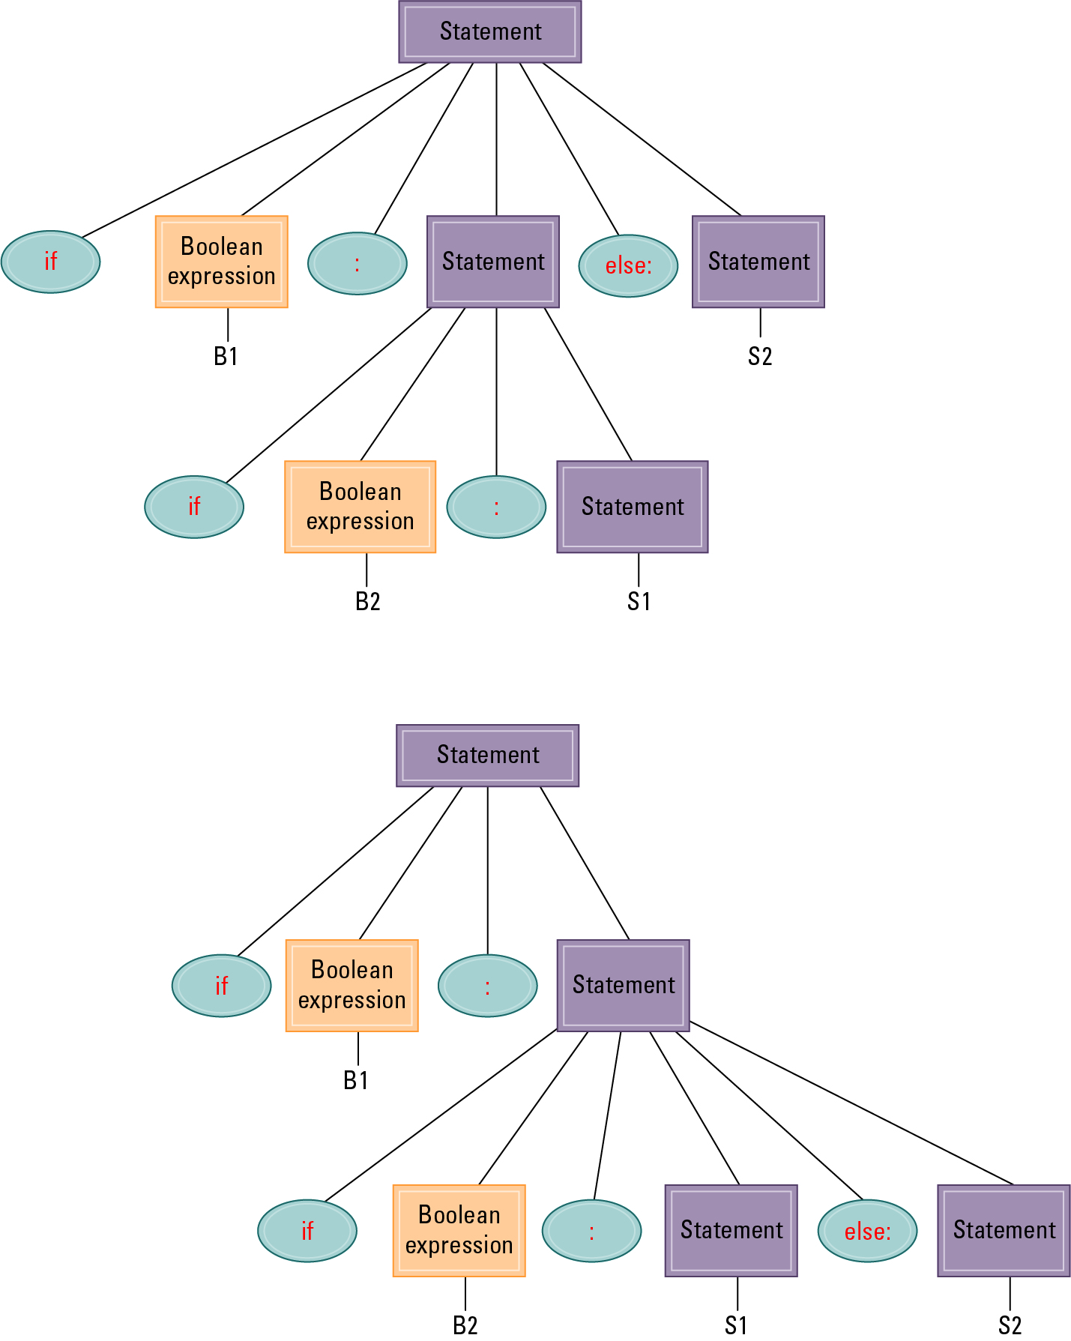
Figure 6.17 Two distinct parse trees for the statement if B1 then if B2 then S1 else S2
Copyright © 2019 Pearson Education, Ltd. All Rights Reserved.

Slide 37
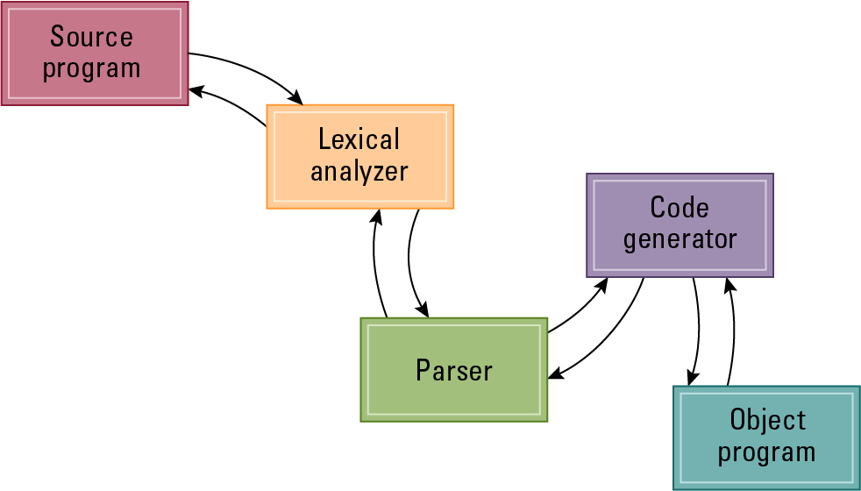
Figure 6.18 An object-oriented approach to the translation process

Slide 38
6.5 Object-Oriented Programming
Object: Active program unit containing both data and procedures
Class: A template from which objects are constructed
An object is called an instance of the class.

Slide 39
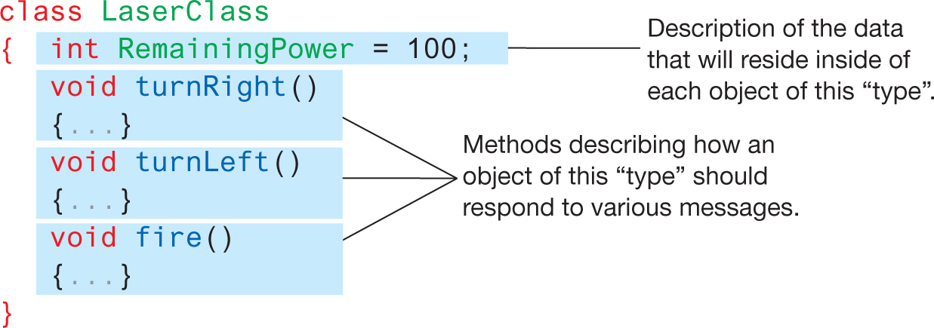
Figure 6.19 The structure of a class describing a laser weapon in a computer game

Slide 40
Components of an Object
Instance Variable: Variable within an object
  Holds information within the object
Method: Procedure within an object
  Describes the actions that the object can perform
Constructor: Special method used to initialize a new object when it is first constructed

Slide 41
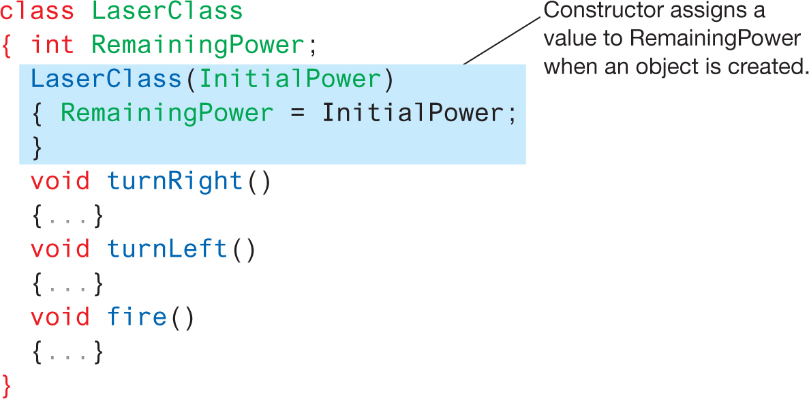
Figure 6.21 A class with a constructor

Slide 42
Object Integrity(物件完整性)
Encapsulation: A way of restricting access to the internal components of an object
  Private
  Public

Slide 43
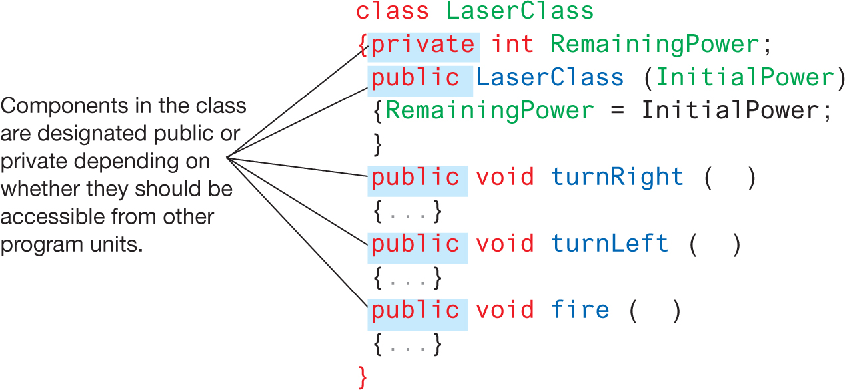
Figure 6.22 Our LaserClass definition using encapsulation as it would appear in a Java or C# program

Slide 44
Additional Object-oriented Concepts
Inheritance: Allows new classes to be defined in terms of previously defined classes
Polymorphism: Allows method calls to be interpreted by the object that receives the call

Slide 45
6.6 Programming Concurrent Activities
Parallel (or concurrent) processing: simultaneous execution of multiple processes
  True concurrent processing requires multiple CPUs
  Can be simulated using time-sharing with a single CPU

Slide 46
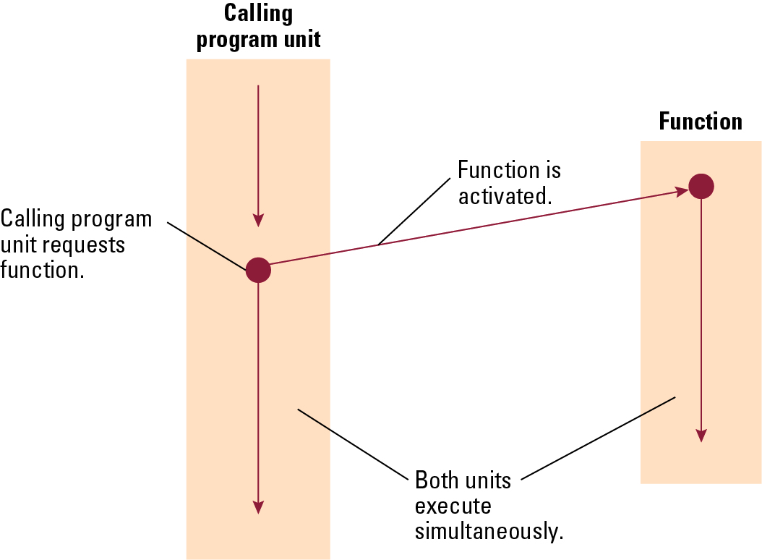
Figure 6.23 Spawning threads

Slide 47
Controlling Access to Data
Mutual Exclusion: A method for ensuring that data can be accessed by only one process at a time
Monitor: A data item augmented with the ability to control access to itself

Slide 48
6.7 Declarative Programming
Resolution: Combining two or more statements to produce a new statement (that is a logical consequence of the originals).
  Example: (P OR Q) AND (R OR ¬Q)
  resolves to (P OR R)
  Resolvent: A new statement deduced by resolution
  Clause form: A statement whose elementary components are connected by the Boolean operation OR
Unification: Assigning a value to a variable so that two statements become “compatible.”

Slide 49
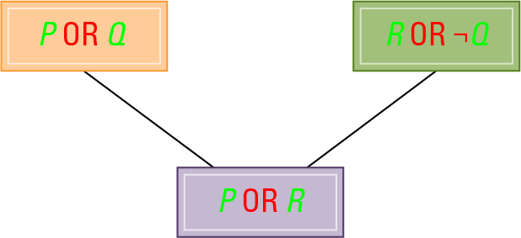
Figure 6.24 Resolving the statements
(P OR Q) and (R OR ¬Q) to produce (P OR R)

Slide 50
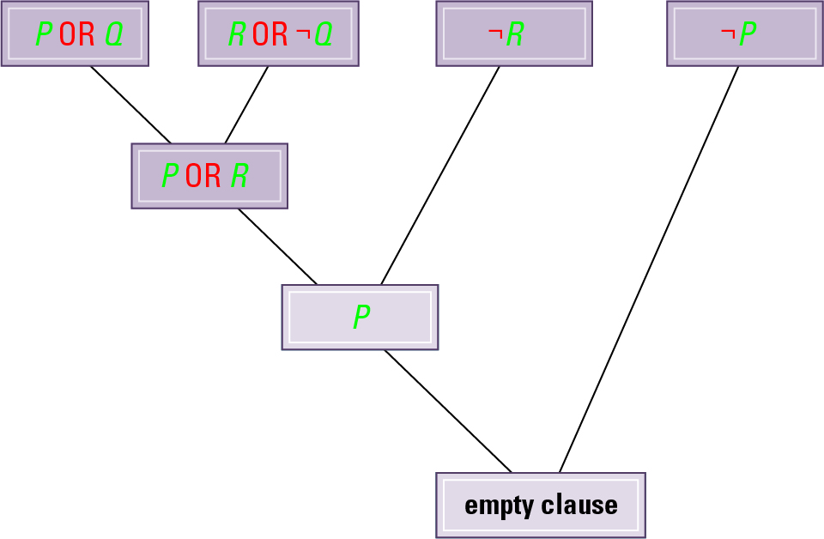
Figure 6.25 Resolving the statements
(P OR Q), (R OR ¬Q), ¬R, and ¬P

Slide 51
Prolog
Fact: A Prolog statement establishing a fact
  Consists of a single predicate
  Form: predicateName(arguments).
    Example: parent(bill, mary).
Rule: A Prolog statement establishing a general rule
  Form: conclusion :- premise.
    :- means “if”
  Example: wise(X) :- old(X).
  Example: faster(X,Z) :- faster(X,Y), faster(Y,Z).

